Slide 1
CENSUS BLOCK
Deanna Harris
10/17/2023
Copyright © 2023 Education Service Center Region 11

Slide 2
2023 TIMELINE
Copyright © 2023 Education Service Center Region 11

Slide 3
Copyright © 2023 Education Service Center Region 11

Slide 4
Copyright © 2023 Education Service Center Region 11

Slide 5
CENSUS BLOCK GROUP
Copyright © 2023 Education Service Center Region 11

Slide 6
Copyright © 2023 Education Service Center Region 11

Slide 7
Current version of tool is 1.0.22.0
Copyright © 2023 Education Service Center Region 11

Slide 8
CENSUS BLOCK GROUP TOOL INSTALLATION
Copyright © 2023 Education Service Center Region 11

Slide 9
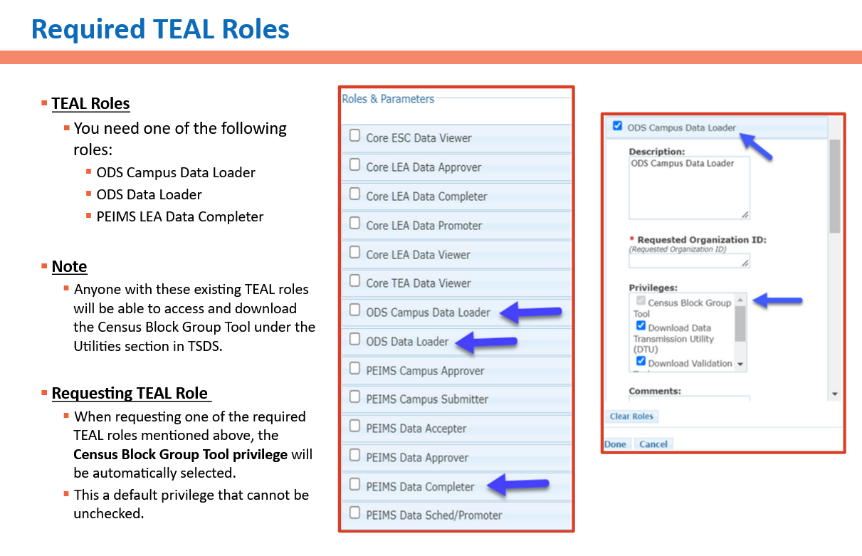
Copyright © 2023 Education Service Center Region 11

Slide 10
Copyright © 2023 Education Service Center Region 11

Slide 11
Copyright © 2023 Education Service Center Region 11

Slide 12
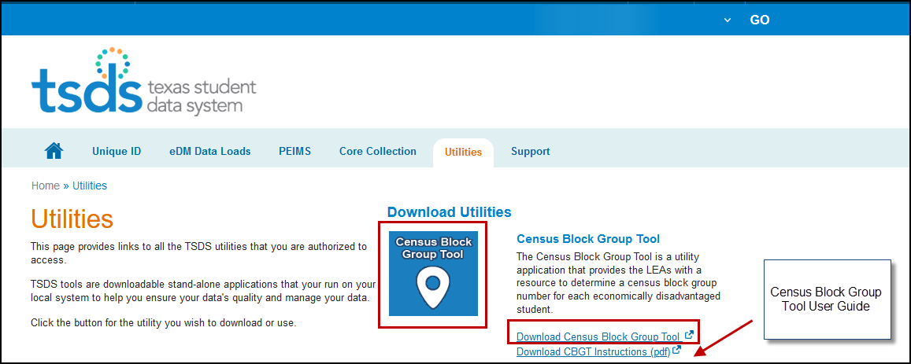
Copyright © 2023 Education Service Center Region 11

Slide 13
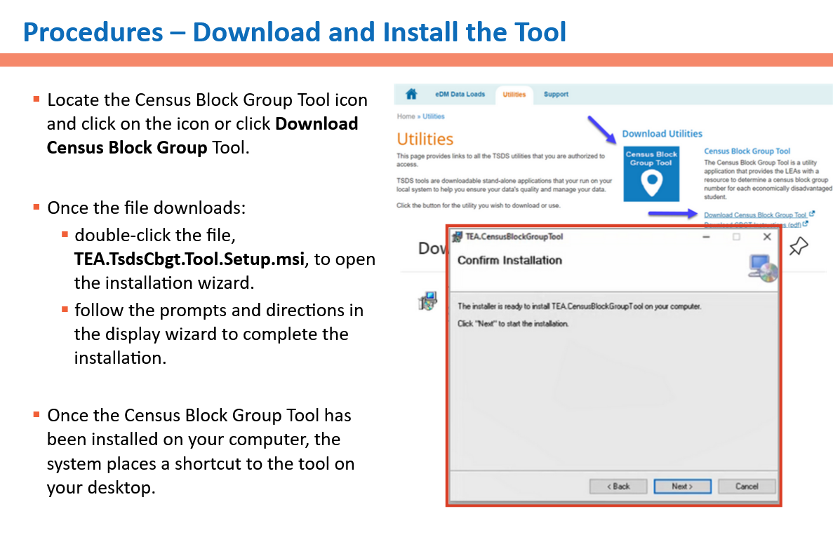
Procedures – Dowload and Install the Tool
Copyright © 2023 Education Service Center Region 11

Slide 14
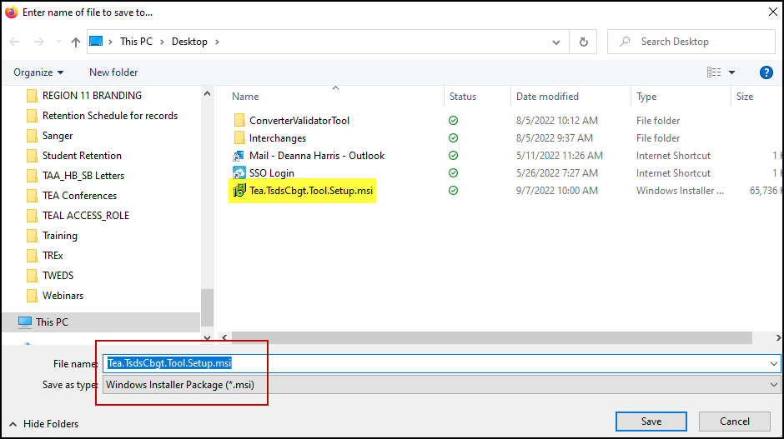
Downloading the Tool
Copyright © 2023 Education Service Center Region 11

Slide 15
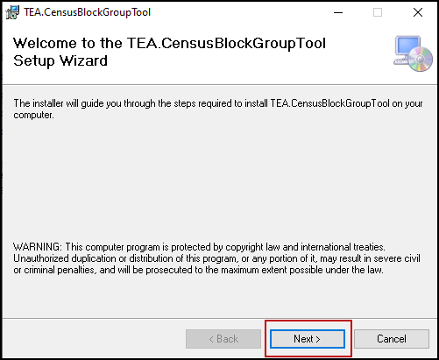
Downloading the Tool
Copyright © 2023 Education Service Center Region 11

Slide 16
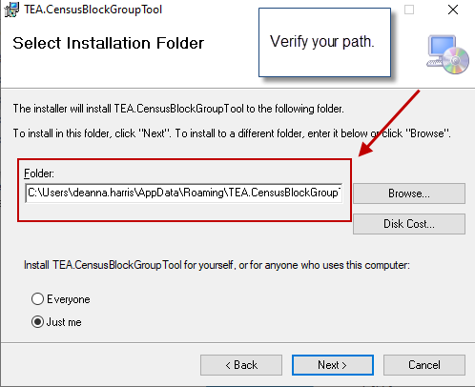
Downloading the Tool
Copyright © 2023 Education Service Center Region 11

Slide 17
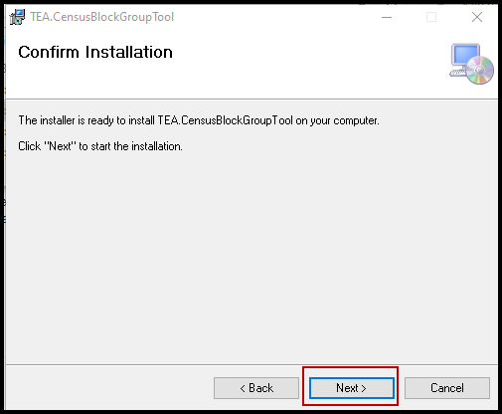
Downloading the Tool
Copyright © 2023 Education Service Center Region 11

Slide 18
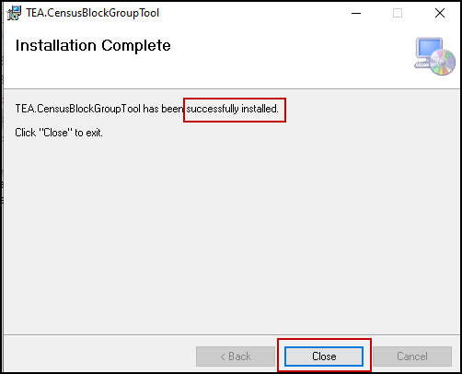
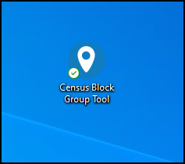
Downloading the Tool
Copyright © 2023 Education Service Center Region 11

Slide 19
MANUAL SINGLE-ENTRY METHOD
Copyright © 2023 Education Service Center Region 11

Slide 20
Single Entry Method
Copyright © 2023 Education Service Center Region 11

Slide 21
Copyright © 2023 Education Service Center Region 11

Slide 22
Copyright © 2023 Education Service Center Region 11

Slide 23
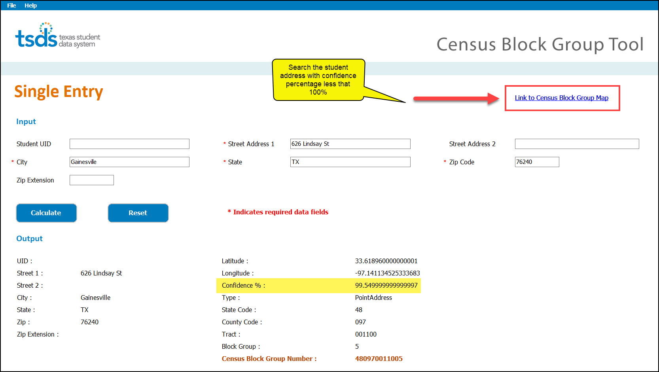
Single Entry Process Demonstration
Copyright © 2023 Education Service Center Region 11

Slide 24
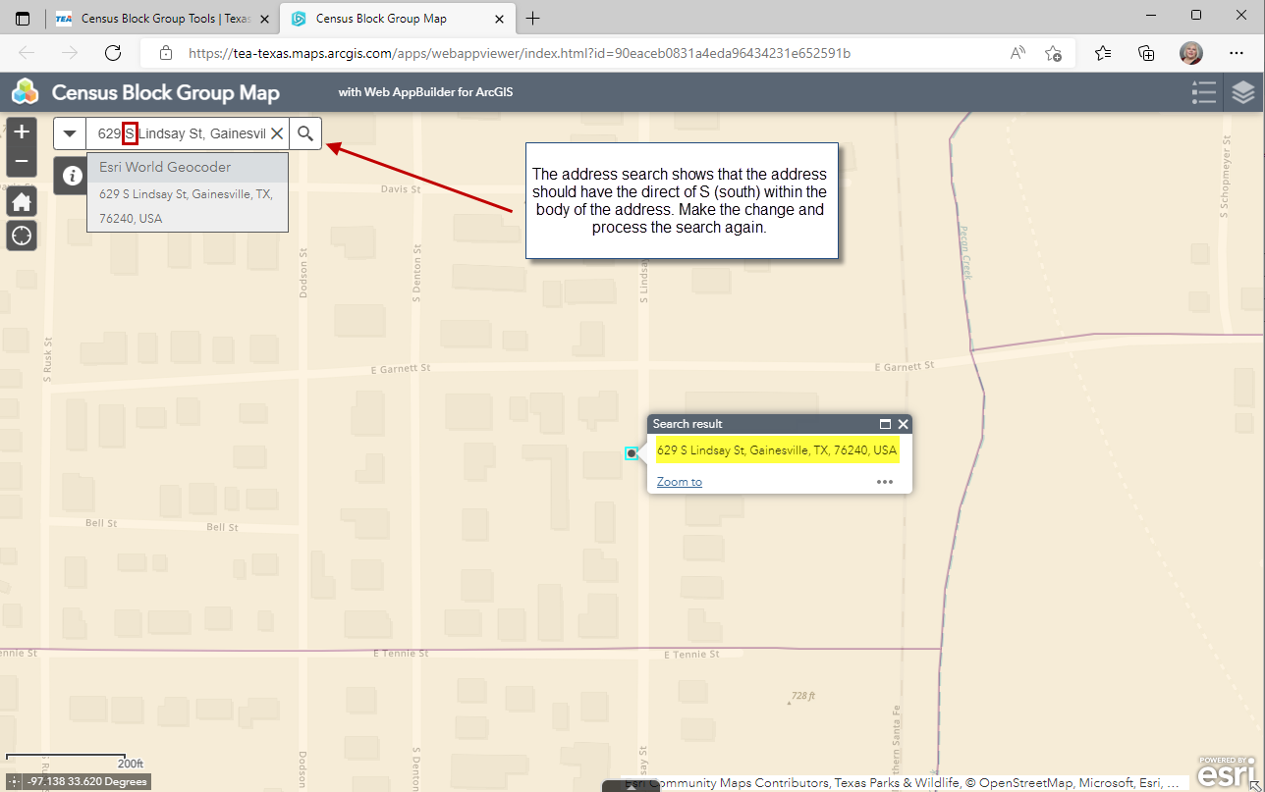
Single Entry Process Demonstration
Copyright © 2023 Education Service Center Region 11

Slide 25
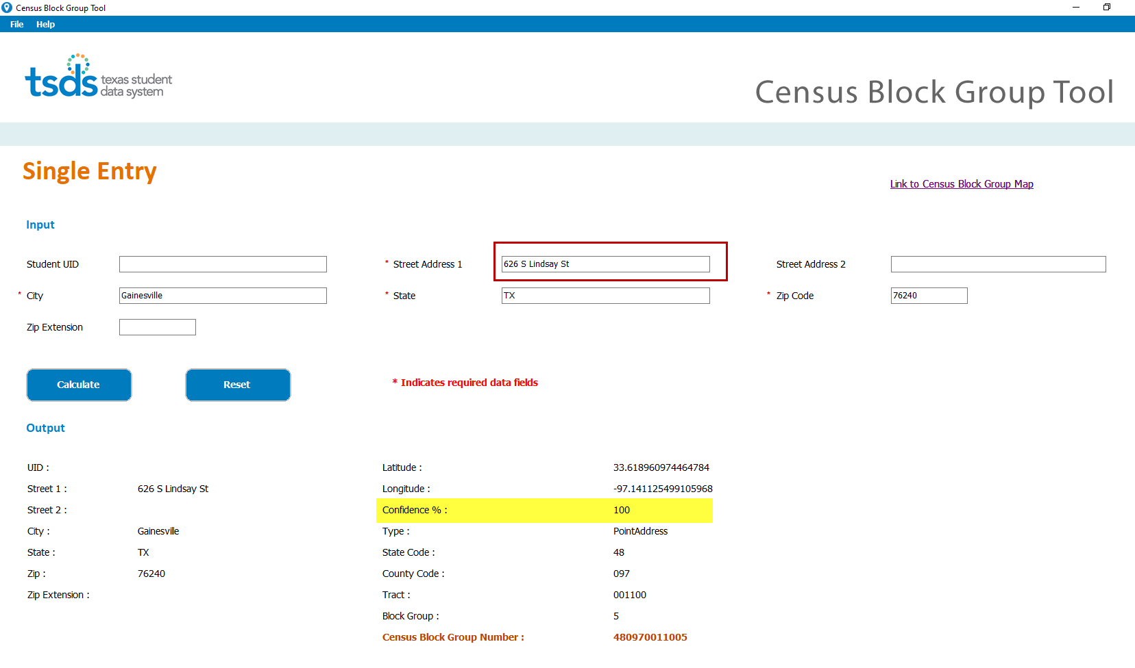
Copyright © 2023 Education Service Center Region 11

Slide 26
Single Entry Process
Once you obtain the student’s Census Block Group Number, you should be able to enter the number directly into your school’s software. Most likely, in the State Reporting/Maintenance area.
Copyright © 2023 Education Service Center Region 11

Slide 27
MULTI-ENTRY UPLOAD METHOD
Copyright © 2023 Education Service Center Region 11

Slide 28
CSV FILE ORGANIZATION
It’s recommended that you create a file folder called Census Block on your computer.
Place the csv file extracted from your SIS in this folder. When you load your csv file into the Census Block Group Tool (CBGT), the output file will be generated and saved to that folder by the CBGT.
The output file will also be available to save and open within the Census Block Group Tool.
If errors are found, you will be able to view them by clicking on the link provided next to the output file.
Copyright © 2023 Education Service Center Region 11

Slide 29
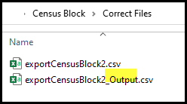
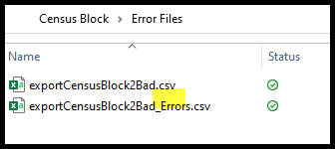
CSV FILE ORGANIZATION EXAMPLE
Non-error output file Error File
Copyright © 2023 Education Service Center Region 11

Slide 30
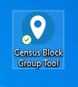
Upload a file from your software
Click on the Census Block Group Tool from your desktop.
Next, click on the folder and select the .csv file extracted from your software.
Copyright © 2023 Education Service Center Region 11

Slide 31
Upload a file from your software
Check the path of the file and record count.
Select
Copyright © 2023 Education Service Center Region 11

Slide 32
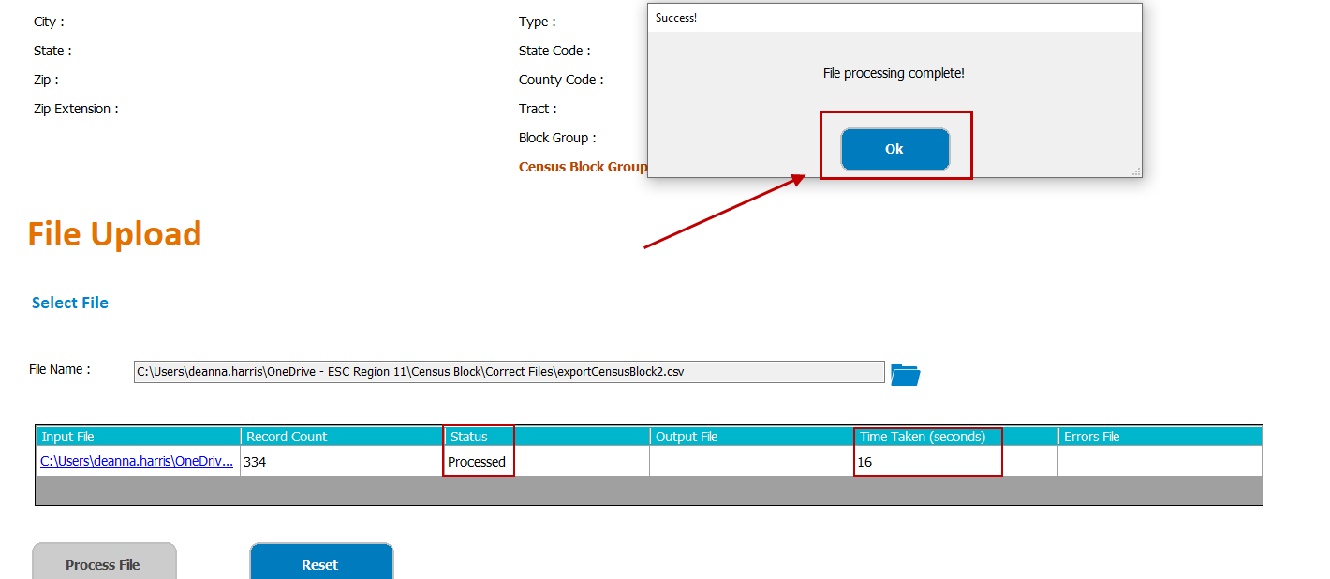
The file has been processed. Click ok to see the output file.
Copyright © 2023 Education Service Center Region 11

Slide 33
Once your output file has been generated, the Census Block Tool will place it in your census block folder. You may click on the output file from the tool or view in your folder.
Copyright © 2023 Education Service Center Region 11

Slide 34
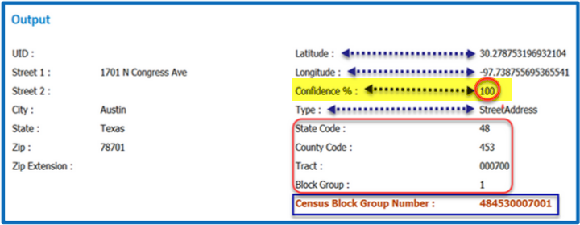
Your file is viewable in notepad from the tool. Below is a sample from our test database. The field order is in the blue bordered screenshot.
Copyright © 2023 Education Service Center Region 11

Slide 35
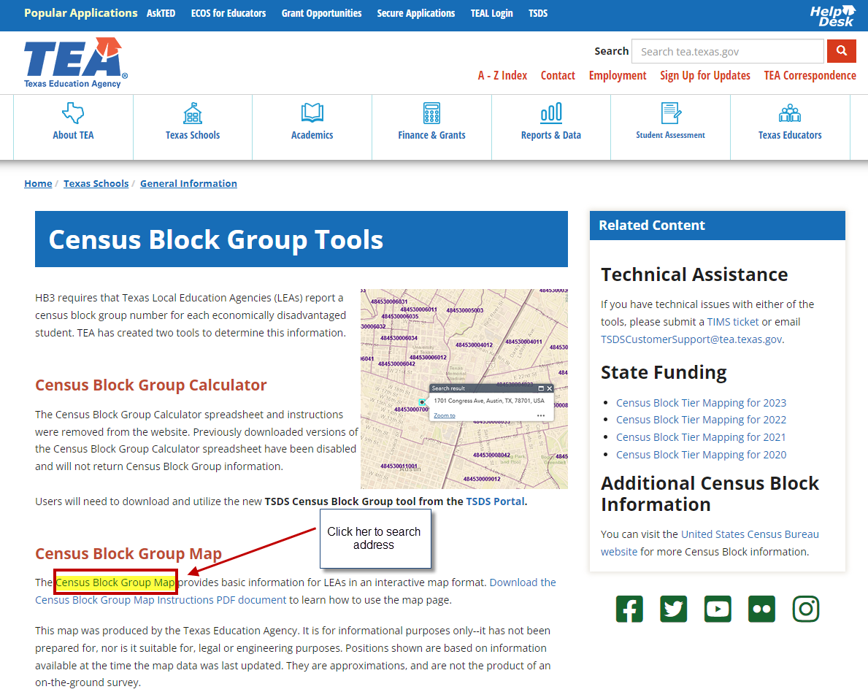
Research any addresses for which the Census Block Group Tool returns a Point or Sub Address with a confidence percentage less than 100%. If the Census Block Group Tool does not return a Point or Sub address, verify the student address using the Census Block Group Map functionality.
Copyright © 2023 Education Service Center Region 11

Slide 36
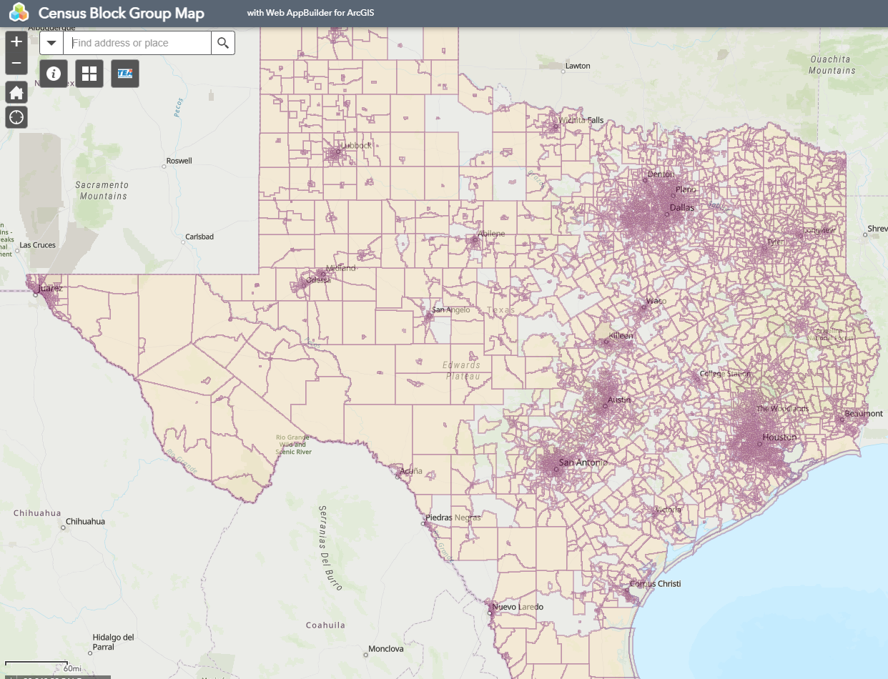
The Census Block Group Map Search page.
Copyright © 2023 Education Service Center Region 11

Slide 37
Confidence Percentage
Addresses that are below 100% confidence level could be due to the street direction error, an FM road listed as a CR (county road), or the city may be incorrect. Any change to an address should be corrected in your software. A new file should be extracted and processed through the Census Block Group Tool to confirm 100% confidence.
This step is very important.
Copyright © 2023 Education Service Center Region 11

Slide 38
FILE UPLOAD ERRORS
Copyright © 2023 Education Service Center Region 11

Slide 39
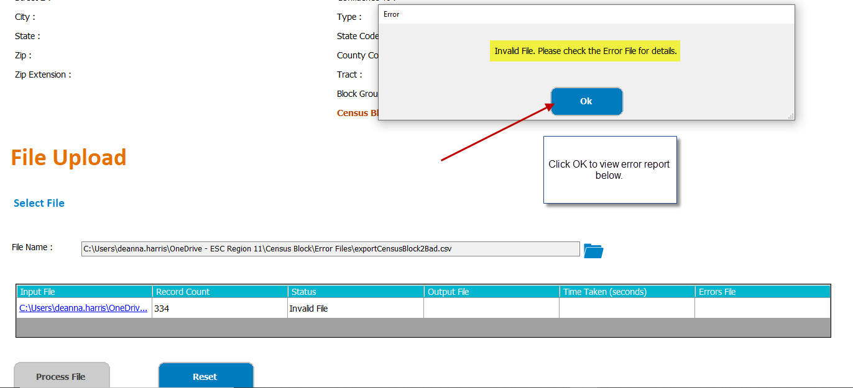
ERROR EXAMPLES
Copyright © 2023 Education Service Center Region 11

Slide 40
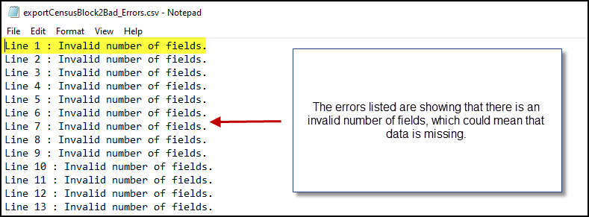
Copyright © 2023 Education Service Center Region 11

Slide 41
Resources
Census Block Group Tool Website
Census Block Group Map Instructions
Download Census Block Group tool (Log into TSDS Portal)
Download Census Block Group Tool User Guide (Log into TSDS Portal)
Link to Census Block Group Map
If you have Technical issues, please submit a TIMS ticket or email TSDSCustomerSupport@tea.Texas.gov
Copyright © 2023 Education Service Center Region 11

Slide 42
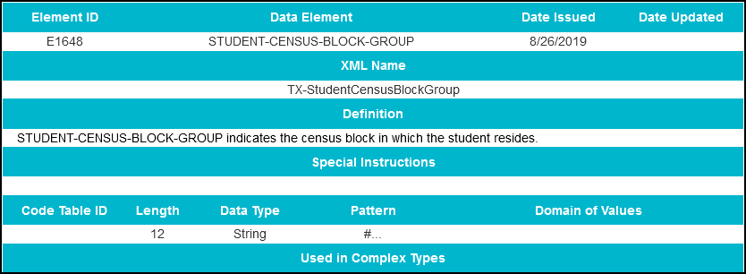
Resources - TWEDS
Copyright © 2023 Education Service Center Region 11

Slide 43
Resources - TWEDS
Copyright © 2023 Education Service Center Region 11

Slide 44
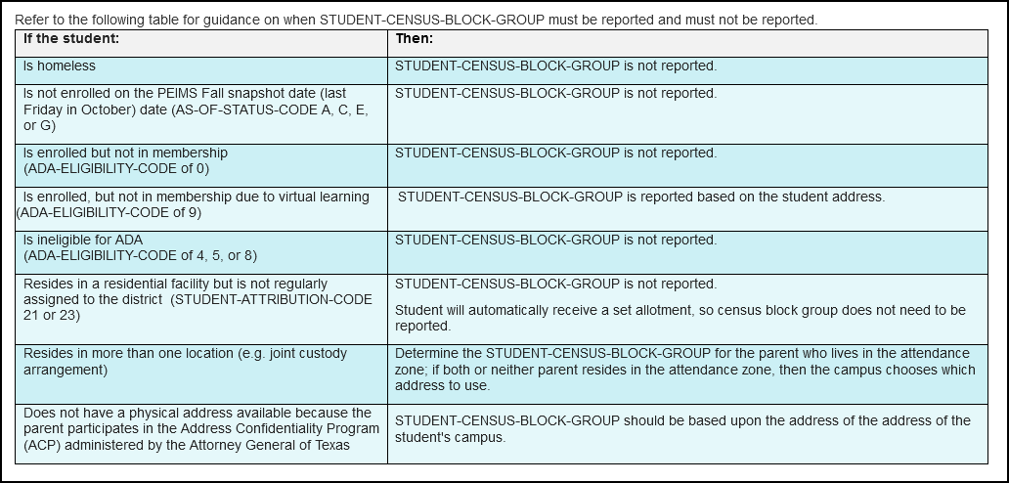
Resources - TWEDS
Copyright © 2023 Education Service Center Region 11

Slide 45
Census Block Group Tool – Updates
If a new version of the Census Block Group Tool is available, the following
message is displayed:
A new version of Census Block Group Tool is available. Would you like to
download and install?
Chose the following option:
1. Click YES to prompt the system to close the application and begin installation of the new version. Then, on the Welcome to the TEA Census Block Group Tool Setup pages, read the installation information and continue to click Next as needed to launch the installation.
Copyright © 2023 Education Service Center Region 11

Slide 46
Tips & Reminders
The Census Block Group Tool IDs will not be updated again until the 2030 Census.
You must delete and reassign census block number each school term.
For the File Upload entry method, it is recommended not to exceed more than 5,000 records per upload. If you encounter uploading significantly less file counts, submit a TIMS ticket. TEA will not know about a problem unless you report it through TIMS.
In order to access and download the Census Block Group Tool under the Utilities section in TSDS, you must have the appropriate roll.
The Census Block Group Tool User Guide is a valuable resource. Additional information about creating a .csv file manually is detailed.
Limited Consent: ESC Region 11 grants permission to attendees of this session to reproduce and distribute designated resources and materials provided during the presentation.
Copyright © 2023 Education Service Center Region 11

